Slide 1
Differences in vocal emotion perception between
amateur singers and instrumentalists
April 29th 2025 | Jessica Dethloff, Dr. Christine Nussbaum

Slide 2
What we know so far
Humans infer emotions from voices above chance → individual variability
Musicality
Musicians outperform non-musicians (small to moderate effect sizes) (Martins et al., 2021; Nussbaum & Schweinberger, 2021)
predisposed auditory sensitivity → pitch/fundamental frequency (F0), melody, timbre, rhythm (Correia et al., 2022; Schellenberg & Lima, 2024)
→ What role do different forms of musical engagement and different levels of musical expertise play?
Notes:
- In previous research, musicality has been shown to benefit vocal emotion perception. This is likely due to an increased auditory sensitivity to acoustic cues, such as fundamental frequency (F0) and timbre (perceived voice quality (i.e. whether it sounds harsh or gentle)), among musicians.
- Correia et al. (2022) found that the link between music training and vocal emotion perception was fully mediated via these auditory perception skills. The association between auditory perception and vocal emotion recognition was even observed in the absence of any formal musical training (Correia et al., 2022; Nussbaum et al., 2024).
However, it is unclear how musicians with different forms of engagement or different levels of expertise differ from each other in their use of these acoustic cues to infer emotional meaning from speech prosody.
“A particularly interesting distinction in the context of vocal emotions is the one between singers and instrumentalists, as singing is arguably the form of musical expression that is most closely related to vocal emotions (Akkermans et al., 2019; Mithen et al., 2006).”
“Another interesting debate evolves around differences between professional musicians and amateurs.”

Slide 3
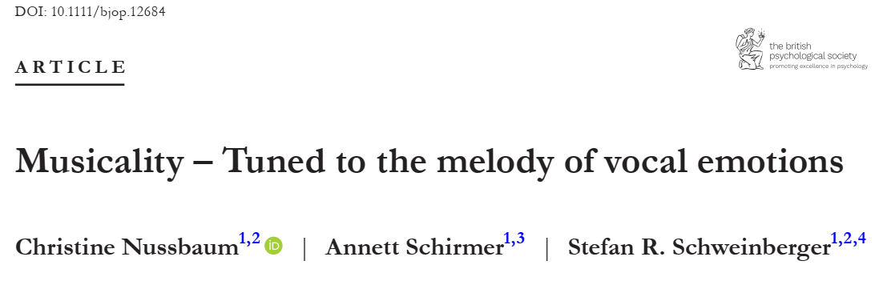
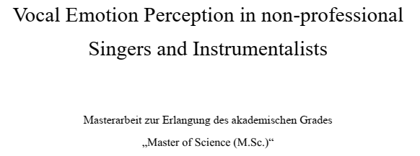
Two studies
(2024, British Journal of Psychology)
(manuscript in preparation)
Professionals | Non-musicians
N = 39 | N = 38
Behavioral & EEG data
Amateurs
Singers | Instrumentalists
N = 45 | N = 44
Only behavioral data

Slide 4
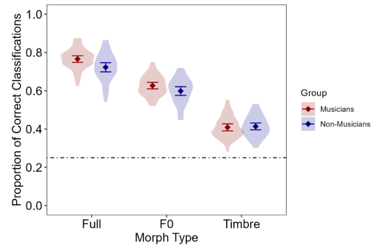
Vocal Emotion Classification - Stimuli
Parameter-specific voice morphing
(Tandem-STRAIGHT; Kawahara et al., 2008, 2013)
Vocal stimuli expressed emotions through
fundamental frequency contour only (F0)
timbre only
a combination of both (Full)
*
*
Nussbaum, Schirmer & Schweinberger, 2024
Notes:
Morphing-Technology
can manipulate voice recordings in such a way that emotion is, e.g., only conveyed through pitch or timbre
The other parameters are manipulated that they hold no emotional information
With this, we can investigate which role specific parameters play für emotion recognition & classificaiton
Nussbaum, Schirmer, Schweinberger, 2024
professionals outperformed non-musicians in Full- and F0-morph conditions
no difference in the Timbre-morph condition

Slide 5
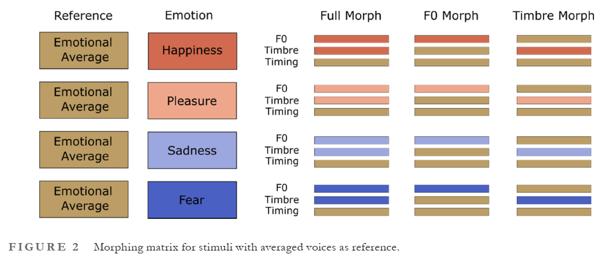

Vocal Emotion Classification - Stimuli
Nussbaum, Schirmer & Schweinberger, 2024
Notes:
- three pseudowords (/molen/, /loman/, /belam/), with expressions of four emotions (happiness, pleasure, fear and sadness
- procedure: participants listened to voice stimuli (play one?), then were tasked to decide whether the voice sounded happy, sad, fearful or expressed pleasure

Slide 6
Musical Skills
Profile of Music Perception Skills (PROMS)
Subtests
Pitch
Melody
Timbre
Rhythm
Law & Zentner, 2012
Notes:
We also measured musical skills via the PROMS.
Then correlated the musical skills with the emotion classification.

Slide 7
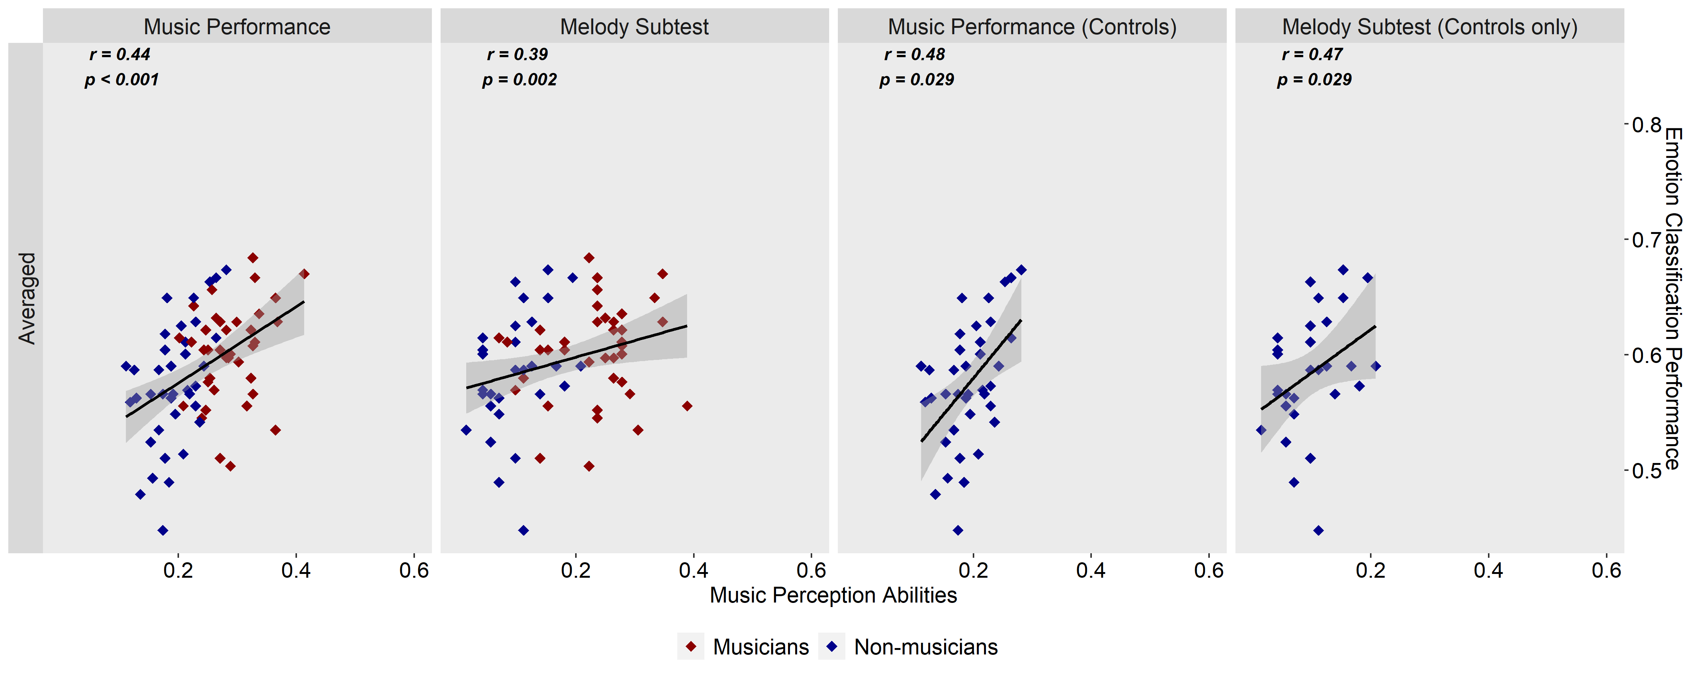
Musical Skills
Profile of Music Perception Skills (PROMS)
Subtests
Pitch
Melody
Timbre
Rhythm
Law & Zentner, 2012
Nussbaum, Schirmer & Schweinberger, 2024
Notes:
First study found nice exploratory correlational findings
“The link between acoustic sensitivity towards melodies and vocal emotional skills even persists in the absence of any musical training”

Slide 8
Musical Skills
Profile of Music Perception Skills (PROMS)
Subtests
Pitch
Melody
Timbre
Rhythm
Law & Zentner, 2012
Goldsmiths Musical Sophistication Index
(Gold-MSI)
Self-reported musical skills
Active Engagement
Formal education
Emotion
Singing
Perception
Müllensiefen et al., 2014

Slide 9
Part 1 - Singers vs. Instrumentalists

Slide 10
Hypotheses
Singers vs. Instrumentalists
H1: NO difference between singers and instrumentalists in overall vocal emotion recognition performance.
H2: NO difference between singers and instrumentalists in vocal emotion recognition performance based on timbre and F0 cues only.

Slide 11

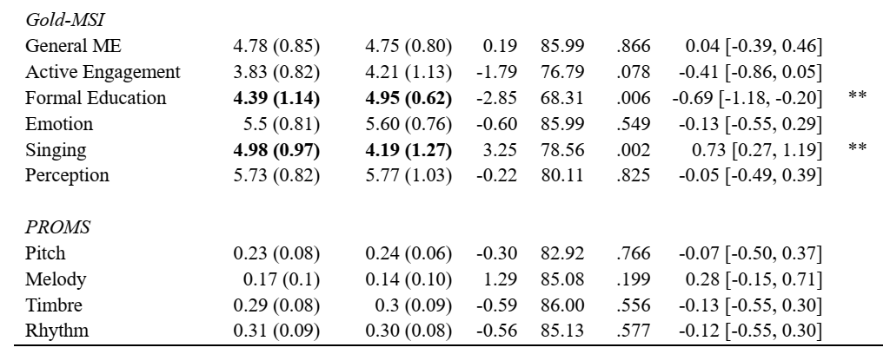
Results Musical Skills

Slide 12
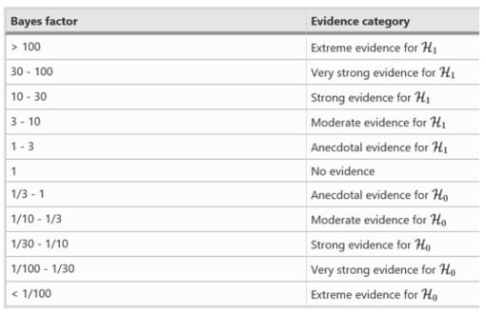
Results Bayes factor interpretation
(Rosenfeld & Olson, 2021)
Notes:
Because we predicted null findings: most suited methods is Bayesian testing (in master thesis, I employed ANOVA and such)
3 – 10 = H1 is 3times more probable than H0
1/10 – 1/3 = H1 is 1/3 more probable than H0 -> H0 is 3times more probable than H0

Slide 13
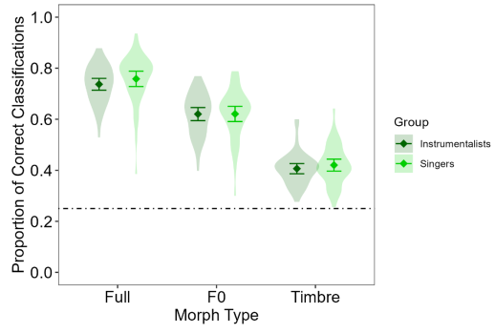
Results Vocal Emotion Classification
Null effect of group for
overall performance (p = .542, BF₁₀ = 0.265)
Full morphs (p = .392, BF₁₀ = 0.31)
F0 morphs (p = .935, BF₁₀ = 0.226)
Timbre morphs (p = .555, BF₁₀ = 0.262)
BF₁₀ < 0.33 indicated moderate evidence for the null hypotheses
Notes:
Singers and instrumentalists did not significantly differ in their vocal emotion perception performance in any condition.

Slide 14

Hypotheses & Conclusion
Singers vs. Instrumentalists
H1: NO difference between singers and instrumentalists in overall vocal emotion recognition performance
H2: NO difference between singers and instrumentalists in vocal emotion recognition performance based on timbre and F0 cues only.
Different forms of musical engagement (singing vs. playing an instrument) do not influence vocal emotion perception.

Slide 15
Part 2 – Professionals vs. Amateurs vs. Non-Musicians

Slide 16
Hypotheses
Professionals vs. Amateurs vs. Non-Musicians
H3: Amateur musicians outperform non-musicians in overall vocal emotion recognition and in the F0 condition.
H4: Amateurs perform equal or better to professional musicians in overall vocal emotion recognition and in the F0 condition.

Slide 17

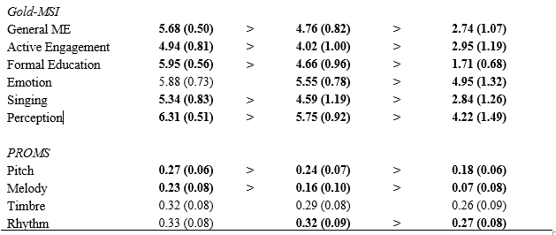
Results Musical Skills
Notes:
different levels of auditory sensitivity observed in music perception skills?
professionals better than amateurs in the PROMS subtests concerning pitch and melody discrimination (medium and large effect sizes respectively) and both musician groups outperformed non-musicians.

Slide 18
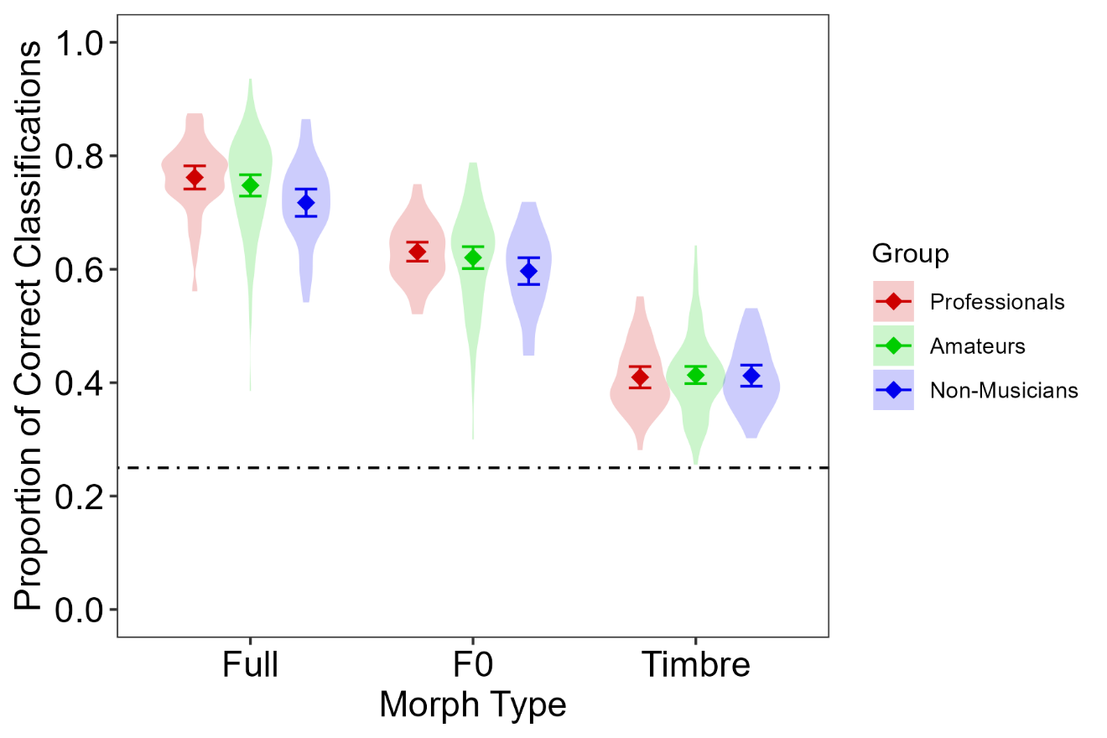
Results Vocal Emotion Classification
professionals vs. amateurs
moderate evidence for null effect of groups for
overall performance (p = .473, BF₁₀ = 0.238)
Full morphs (p = .322, BF₁₀ = 0.286),
F0 morphs (p = .435, BF₁₀ = 0.245)
Timbre morphs (p = .840, BF₁₀ = 0.205)
amateurs vs. non-musicians
inconclusive evidence for null effect of groups
overall performance (p = .107, BF₁₀ = 0.546),
Full morphs (p = .044, BF₁₀ = 1.009)
F0 morphs (p = .105, BF₁₀ = 0.576)
moderate evidence for null effect of
Timbre morphs (p = .975, BF₁₀ = 0.205).
→ BF₁₀ < 0.33 indicated moderate evidence for the null hypotheses
Notes:
Bayes Kleiner als 3 (was Beweis conclusive wäre)
amateurs
performed equally to professionals in full-, F0- and timbre-modulated conditions
Inconclusive evidence for comparison with non-musicians
(ANOVA: amateurs performed better than non-musicians in full-modulated condition, but not in F0-modulated condition)
(In both these conditions, professionals outperformed non-musicians; see Nussbaum, Schirmer & Schweinberger, 2024)
There were no differences between the groups in a timbre-modulated condition.
→ “Amateurs were better than non-musicians only in the condition with full emotion modulation, whereas professionals outperformed non-musicians additionally in the condition where only pitch was emotionally informative.”

Slide 19

Hypotheses & Conclusion
Professionals vs. Amateurs vs. Non-Musicians
H3: Amateur musicians outperform non-musicians in overall vocal emotion recognition and in the F0 condition.
H4: Amateurs perform equal or better to professional musicians in overall vocal emotion recognition and in the F0 condition.
It is unclear whether there are differences between amateurs and non-musicians regarding their vocal emotion perception.
Different levels of musical expertise (professional vs. amateur) do not influence vocal emotion perception.
Notes:
H3: inconclusive → maybe power issue [if difference exists, it`s maybe too small to be detected]
H4: Assuming that a main difference between amateurs and professionals lies in professionals undergoing more extensive formal training and/or practicing more regularly (as seen in the corresponding Gold-MSI scores), the similarities in performance further support that the amount of (formal) music training is not the main influence of musicality on vocal emotion perception
(ANOVA: amateurs performed better than non-musicians in full-modulated condition, but not in F0-modulated condition)
(In both these conditions, professionals outperformed non-musicians; see Nussbaum, Schirmer & Schweinberger, 2024)

Slide 20
Part 3 - Correlations

Slide 21
Hypotheses Singers vs. Instrumentalists
Correlations with PROMS:
H5: Averaged vocal emotion recognition (VER) performance is correlated with averaged music perception performance.
H6: Full-VER and F0-VER are correlated with melody perception in music.
Correlations with the GOLD-MSI:
H7: Averaged-VER and Full-VER are correlated with the General-ME.
H8: Averaged-VER and Full-VER are correlated with the Perception Subscale.
H9: Averaged-VER and Full-VER are correlated with self-rated singing abilities.
Nussbaum, Schirmer & Schweinberger, 2024

Slide 22
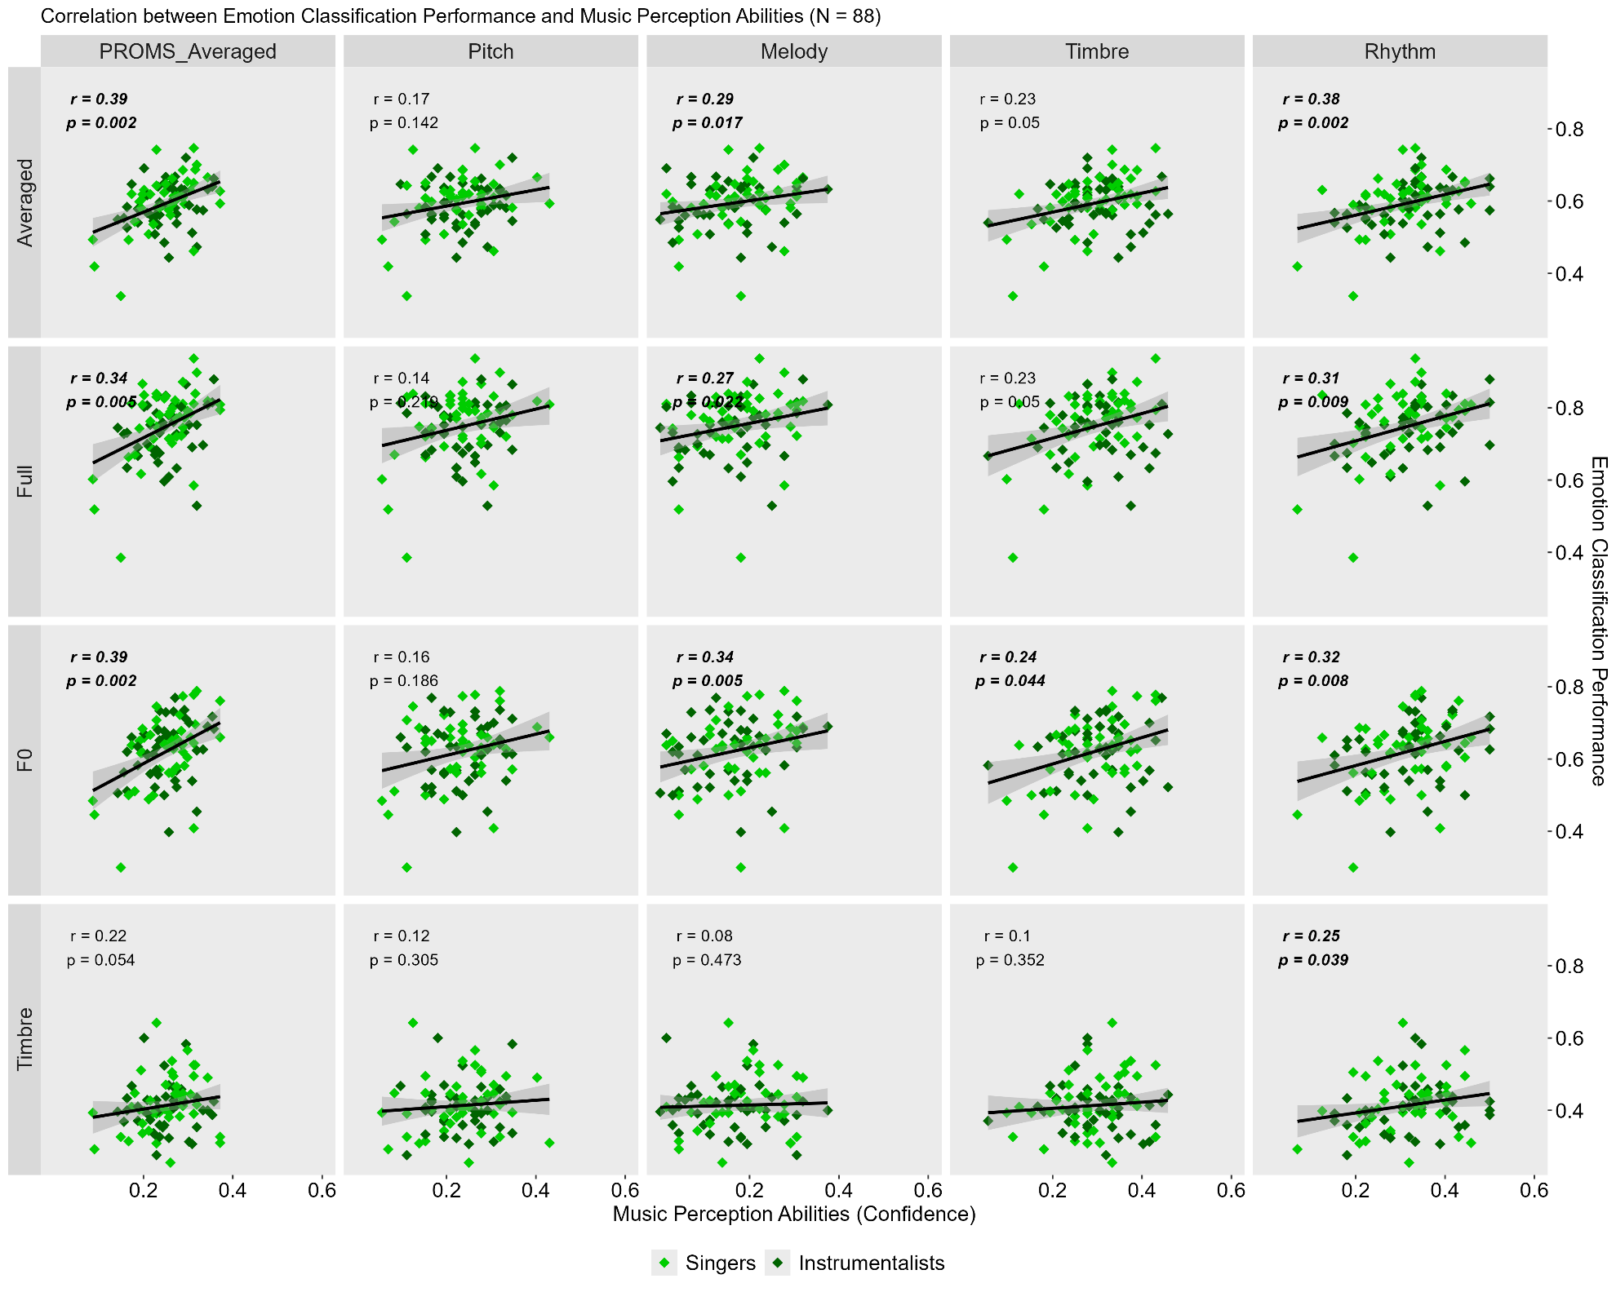
Results PROMS
Strong correlation of
overall vocal emotion recognition performance with average PROMS
(ρ(86) = .39, p = .002)
Notes:
First correlation also emerged in a separate analysis of singers (ρ(43) = .52, p = .005), but was non-significant in instrumentalists (ρ(41) = .23, p = .326), possibly due to reduced variance.
Correlation confirms first study, where the same correlation showed for professionals and non-musicians: music perception is linked to emotion perception.

Slide 23
Results PROMS
Strong correlation of
overall vocal emotion recognition performance with average PROMS
(ρ(86) = .39, p = .002)
Strong correlations of overall vocal emotion recognition performance with subtests for
melody (ρ(86) = .29, p = .017) and
rhythm (ρ(86) = .38, p = .002)
Notes:
Examining the correlational patterns based on the different subtests of the PROMS revealed that
the Melody and Rhythm subtests were strong in predicting emotion perception performance (with explained variances between 8.4 and 14,4 %)
while pitch and timbre subtests had no significant predictive value (if sign.: between 2.9 and 5.3% explained variance)
The perception of melody and rhythm requires to track acoustic information over time, whereas pitch and timbre are static auditory stimuli
rather than static acoustic information, the processing of dynamic cues is of particular importance for emotion perception.
The role pitch plays for inferring vocal emotions seems to relate especially to how an individual is able to track its changes over time, i.e. the pitch contour or melody.
This mirrors previous findings (Globerson et al., 2013; Greenspon & Montanaro, 2023)

Slide 24
Results PROMS
Correlations between
Full- and F0-morphs with all PROMS subtest, except pitch
(ρs(86) = .23 - .39, ps < .05)
Notes:
Performance in the Full- and F0-morph conditions correlated with all subtests of the PROMS except the pitch subtest.
Notably, the correlations with melody and rhythm were “higher” (.27 - .34) than with timbre (.23 & .24)

Slide 25
Hypotheses & Conclusion Singers vs. Instrumentalists
Correlations with PROMS
H5: Averaged vocal emotion recognition (VER) performance is correlated with averaged music perception performance.
H6: Full-VER and F0-VER are correlated with melody perception in music.
Correlations with the GOLD-MSI
H7: Averaged-VER and Full-VER are correlated with the General-ME.
H8: Averaged-VER and Full-VER are correlated with the Perception Subscale.
H9: Averaged-VER and Full-VER are correlated with self-rated singing abilities.
Notes:
Summarizing, we found the same pattern of correlation in amateurs as in professionals and non-musicians
→ Confirming link between music perception and emotion perception

Slide 26
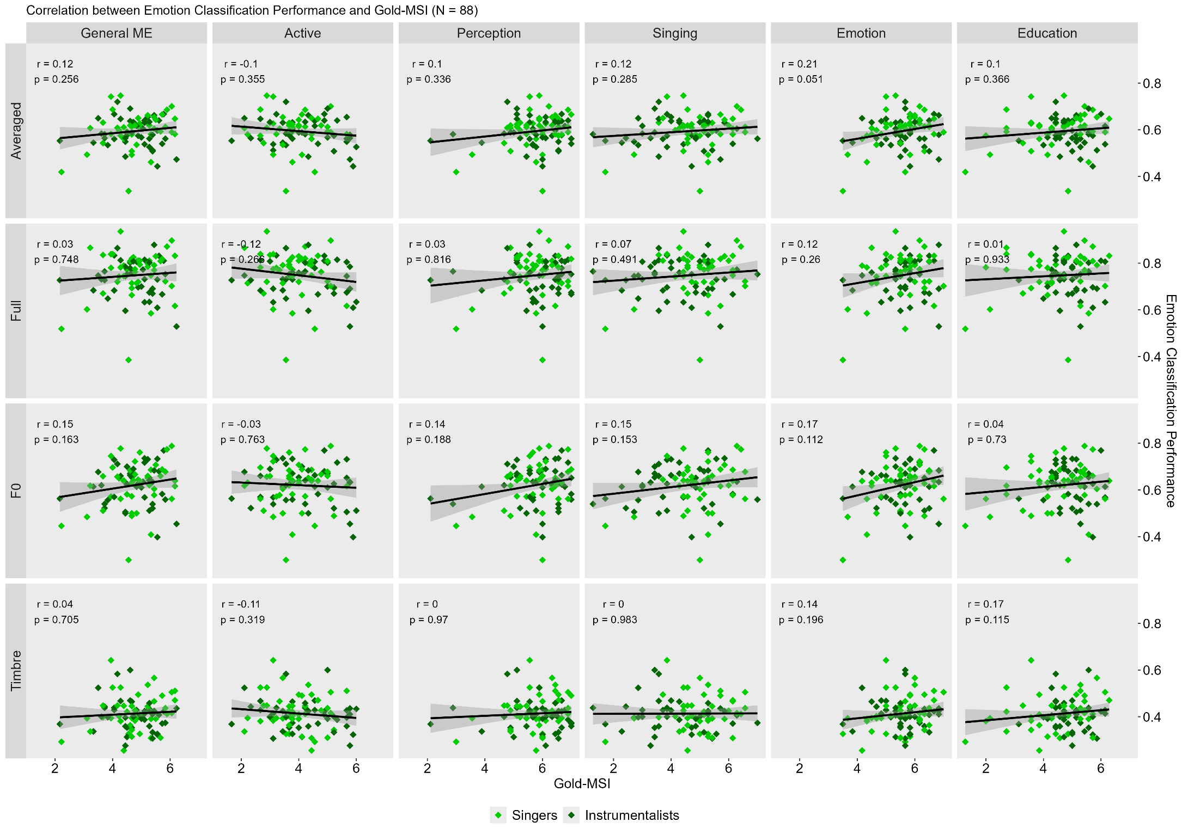
Results Gold-MSI
No correlations of
vocal emotion recognition performance
with self-reported musical skills
Notes:
No corr. with education (music training): emphasizes that music training and its amount not crucial for vocal emotion perception

Slide 27
Hypotheses & Conclusion Singers vs. Instrumentalists
Correlations with PROMS
H5: Averaged vocal emotion recognition (VER) performance is correlated with averaged music perception performance.
H6: Full-VER and F0-VER are correlated with melody perception in music.
Correlations with the GOLD-MSI
H7: Averaged-VER and Full-VER are correlated with the General-ME.
H8: Averaged-VER and Full-VER are correlated with the Perception Subscale.
H9: Averaged-VER and Full-VER are correlated with self-rated singing abilities.
Notes:
No corr. With self-rated music perception skills: surprising in light of contrasting previous findings where self-rated perceptual (and singing) abilities were positively correlated with emotion recognition accuracy (Correia et al., 2022).
contrast to the strong link between vocal emotion perception and performance-based measures of music perception skills found in the present study.
Questionnaires concerning self-rated perceptual abilities do not necessarily accurate reflection of the actual perceptual skills of participants (Dunning, 2005; Mabe & West, 1982) → musicians more self-critical in regard to their musical skills than would be appropriate for their actual skill level (Hewitt, 2015), especially when compared to non-musicians?
Tasks order?
PROMS before Gold-MSI
PROMS assesses a wide range of musical abilities; many amateurs reported in debriefing that it was harder than they had initially assumed. → rate perceptual skills after may have skewed their self-rating
This could be the case especially for amateurs, assuming that professional musicians are more conscious of their own skill level due to constant (self- and external) evaluations and that nonmusicians presumably have lower expectations to excel at musical perception skills.
In Correia et al. (2022), participants filled out the Gold-MSI before any of the perception tasks, which could be a reason for the contrasting findings.

Slide 28
Discussion & Conclusion

Slide 29
Summary
Singers vs. Instrumentalists
H1: NO difference between singers and instrumentalists in overall vocal emotion recognition performance
H2: NO difference between singers and instrumentalists in vocal emotion recognition performance based on timbre and F0 cues only.
Professionals vs. Amateurs vs. Non-Musicians
H3: Amateur musicians outperform non-musicians in overall vocal emotion perception and in the F0 condition.
H4: Amateurs perform equal or better to professional musicians in overall vocal emotion perception and in the F0 condition.

Slide 30
Conclusions
Musicality benefits vocal emotion perception
irrespective of different forms of musical engagement (singing vs. playing an instrument)
irrespective of musical expertise (amateur vs. professional level)
Musicality and vocal emotion perception linked through naturally predisposed auditory sensitivity
particularly dynamic pitch contours (melody)
Notes:
In conclusion, the present study reinforced the notion that individuals with naturally high musical abilities exhibit benefits regarding vocal emotion perception.
While musicians are a very heterogeneous group, neither possible differences between singing vs. playing an instrument nor differences between making music on a professional vs. an amateur level had an empirically observable effect on vocal emotion perception.
Furthermore, instead of group differences concerning musical expertise, vocal emotion perception performance was found to be dependent on where individuals were located on a spectrum of naturally predisposed auditory sensitivity and how they utilized pitch contours to infer emotional meaning from speech. “

Slide 31
Limitations & future directions
Amateur groups (singers vs. instrumentalists) not strictly exclusive from each other
Primarily German speakers in Western music culture
„Ich habe den Eindruck, dass die Stimmlagen in Frankreich und Deutschland unterschiedlich wahrgenommen werden können. Ich frage mich also, ob es einen kulturellen Bias geben könnte?“
Stimuli
Stimuli with two-syllable pseudowords → One syllable? Sentences?
voice-morphing could reduce perceived naturalness of voices → but no effect on perception of vocal emotions (Nussbaum, Pöhlmann, et al., 2023)
Focus on pitch/F0 and timbre cues
Notes:
it is challenging to find singers who have never played an instrument in any capacity or instrumentalists who have never sung.
Instead, participants had to choose between singing vs. playing an instrument when asked about their predominant musical activity. Further, we recruited active members of choirs and orchestras.
This did not preclude participants from ever having engaged with another form of music making (e.g., some singers reported to play an instrument).

Slide 32
Thank you for your attention!

Slide 33
References
Discussed papers
Nussbaum, C., Dethloff, J., Schirmer, A., & Schweinberger, S.R. (manuscript in preparation). No difference in vocal emotion perception between non-professional/amateur singers and instrumentalists (working title).
Senftleben, J. (2024). Vocal Emotion Perception in non-professional Singers and Instrumentalists. [Master’s thesis, Friedrich-Schiller-Universität Jena].
Nussbaum, C., Schirmer, A., & Schweinberger, S. R. (2024). Musicality – Tuned to the melody of vocal emotions. British Journal of Psychology, 115, 206–225. https://doi.org/10.1111/bjop.12684
Further literature
Correia, A. I., Castro, S. L., Macgregor, C., Müllensiefen, D., Schellenberg, E. G. (2022). Enhanced Recognition of Vocal motions in Individuals With Naturally Good Musical Abilities. Emotion, 22(5), 894–906. https://doi.org/10.1037/emo0000770
Kawahara, H., Morise, M., Banno, H., & Skuk, V. G. (2013). Temporally variable multi-aspect N-way morphing based on interference-free speech representations. IEEE International Conference on Acoustics, Speech and Signal Processing, 1–10. https://doi.org/10.1109/APSIPA.2013.6694355
Kawahara, H., Morise, M., Takahashi, T., Nisimura, R., Irino, T., & Banno, H. (2008). Tandem-STRAIGHT: A temporally stable power spectral representation for periodic signals and applications to interference-free spectrum, F0, and aperiodicity estimation. IEEE International Conference on Acoustics, Speech and Signal Processing, 3933–3936. https://api.semanticscholar.org/CorpusID:14929345
Law, L. N. C., & Zentner, M. (2012). Assessing Musical Abilities Objectively: Construction and Validation of the Profile of Music Perception Skills. PLOS ONE, 7(12), 1–15. https://doi.org/10.1371/journal.pone.0052508
Martins, M., Pinheiro, A. P., & Lima, C. F. (2021). Does Music Training Improve Emotion Recognition Abilities? A Critical Review. Emotion Review, 13(3), 199–210. https://doi.org/10.1177/17540739211022035

Slide 34
References
Further literature (continued)
Müllensiefen, D., Gingras, B., Musil, J., & Stewart, L. (2014). The Musicality of Non-Musicians: An Index for Assessing Musical Sophistication in the General Population. PLOS ONE, 9(2), 1–23. https://doi.org/10.1371/journal.pone.0089642
Nussbaum, C., Pöhlmann, M., Kreysa, H., & Schweinberger, S. R. (2023). Perceived Naturalness of Emotional Voice Morphs. Cognition And Emotion, 37(4), 721–747. https://doi.org/10.1080/02699931.2023.2200920
Nussbaum, C., & Schweinberger, S. R. (2021). Links Between Musicality and Vocal Emotion Perception. Emotion Review, 13(3), 211–224. https://doi.org/10.1177/17540739211022803
Rosenfeld, P. J., Olson, J.M. (2021). Bayesian Data Analysis: A Fresh Approach to Power Issues and Null Hypothesis Interpretation. Appl Psychophysiol Biofeedback, 46, 135–140. https://doi.org/10.1007/s10484-020-09502-y
Schellenberg, E. G., & Lima, C. F. (2024). Music Training and Nonmusical Abilities. Annual Review of Psychology, 75, 87–128. https://doi.org/10.1146/annurev-psych-032323-051354

Slide 35
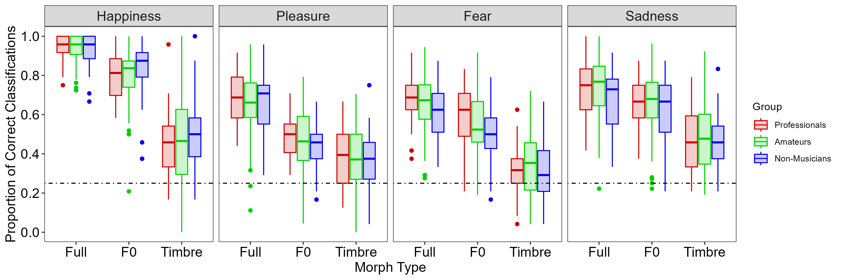
Results Vocal Emotion Classification – All Groups

Slide 36
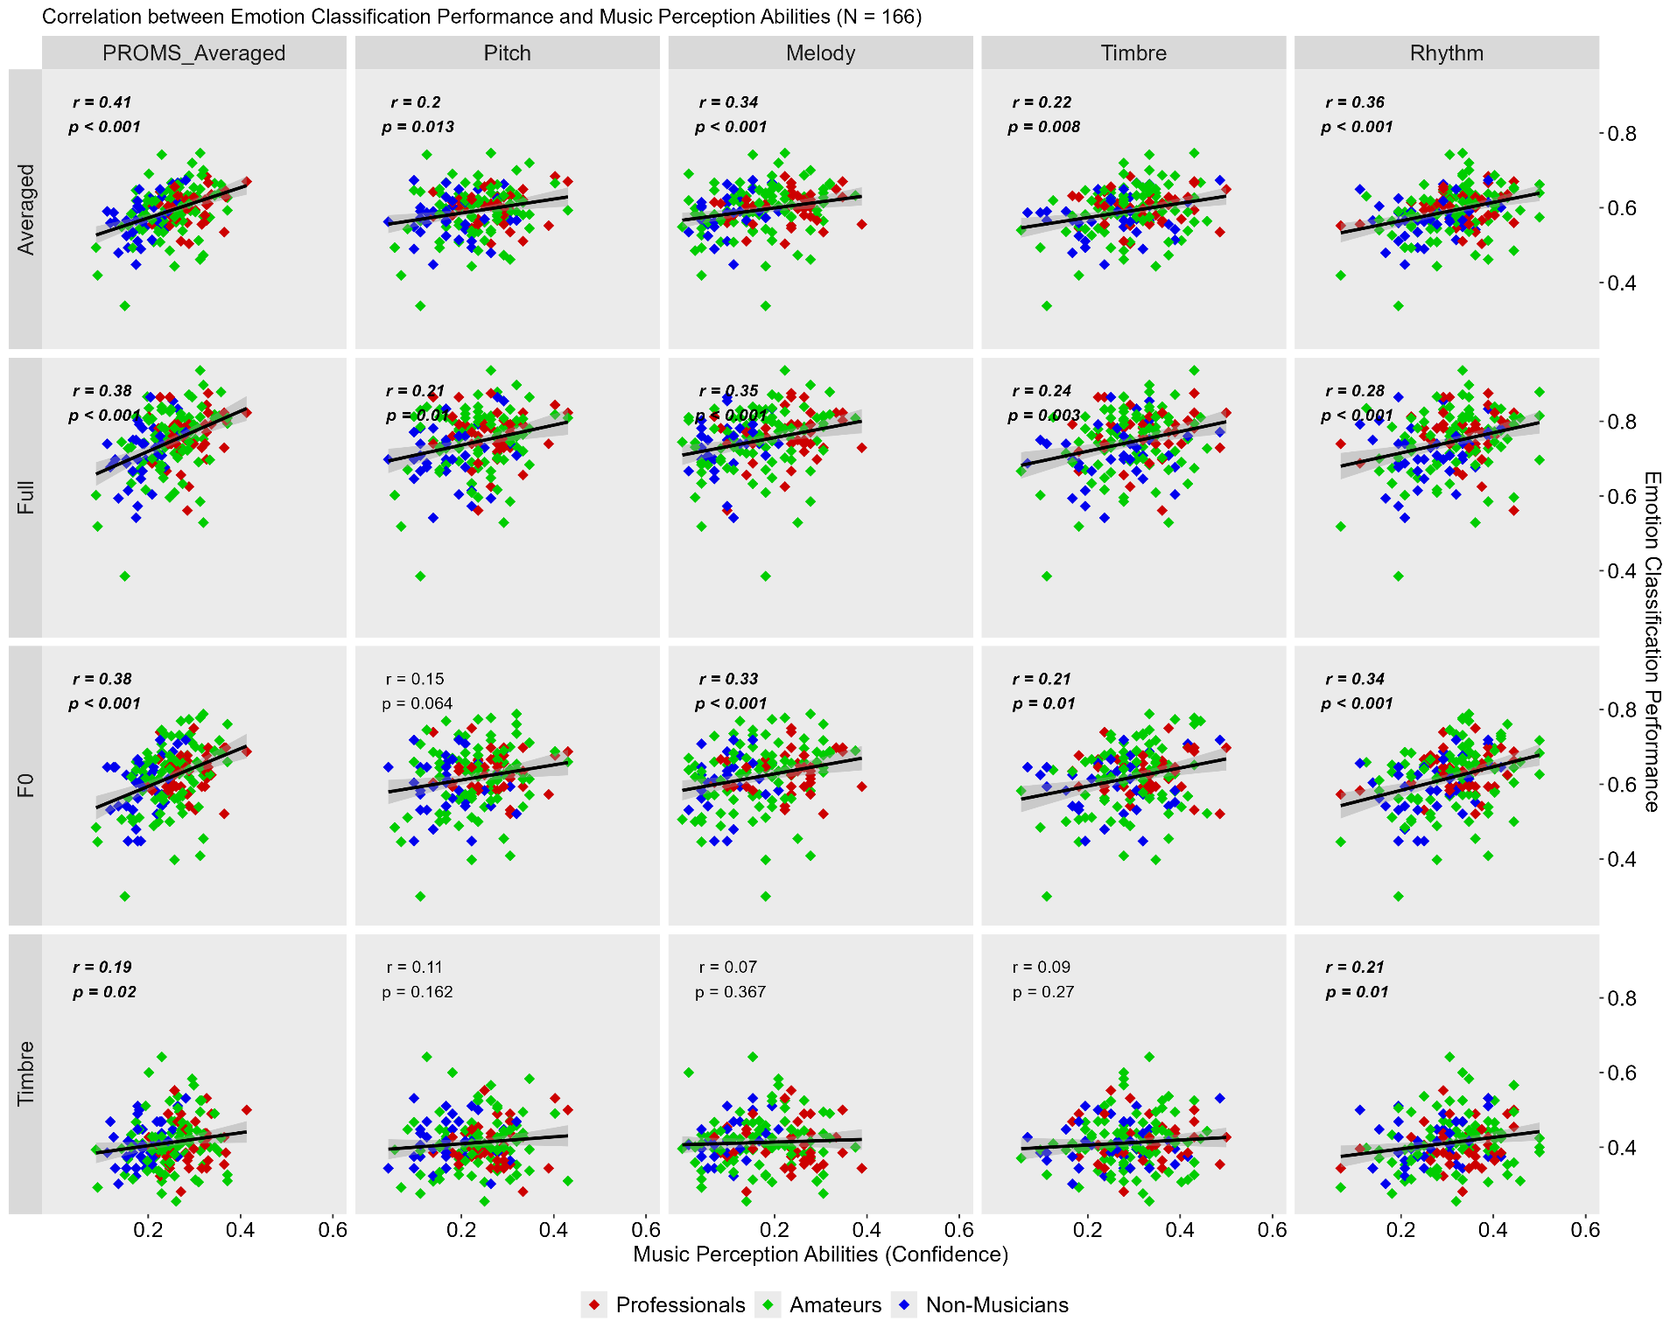
Correlations PROMS - All groups
Notes:
Additionally, exploratory analyses revealed a link between dynamic pitch perception in music and speech that remained when controlling for music training

Slide 37
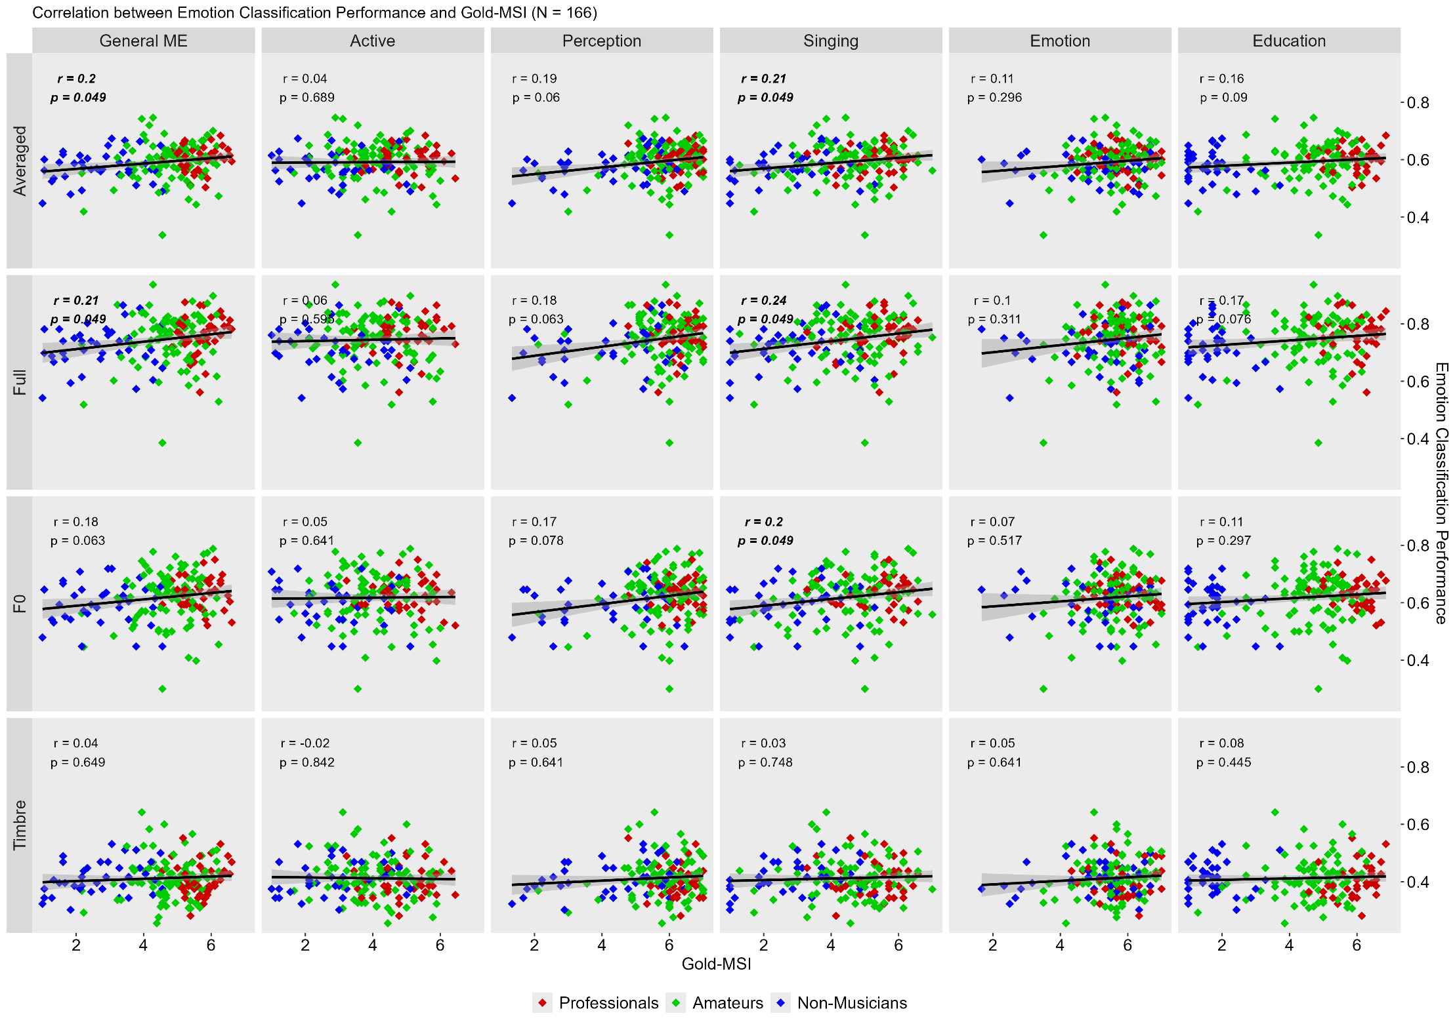
Correlations Gold-MSI – All groups

